Slide 1
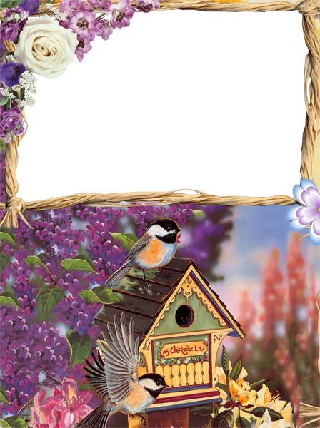

Slide 2
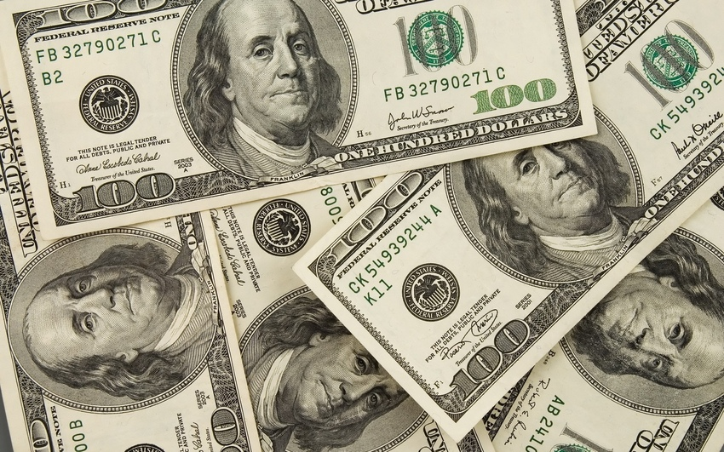
Who takes million?
I

Slide 3
Participants:6 “A” class
6 “Ә” class
6 “B” class
6 “V” class
6 “G” class

Slide 4
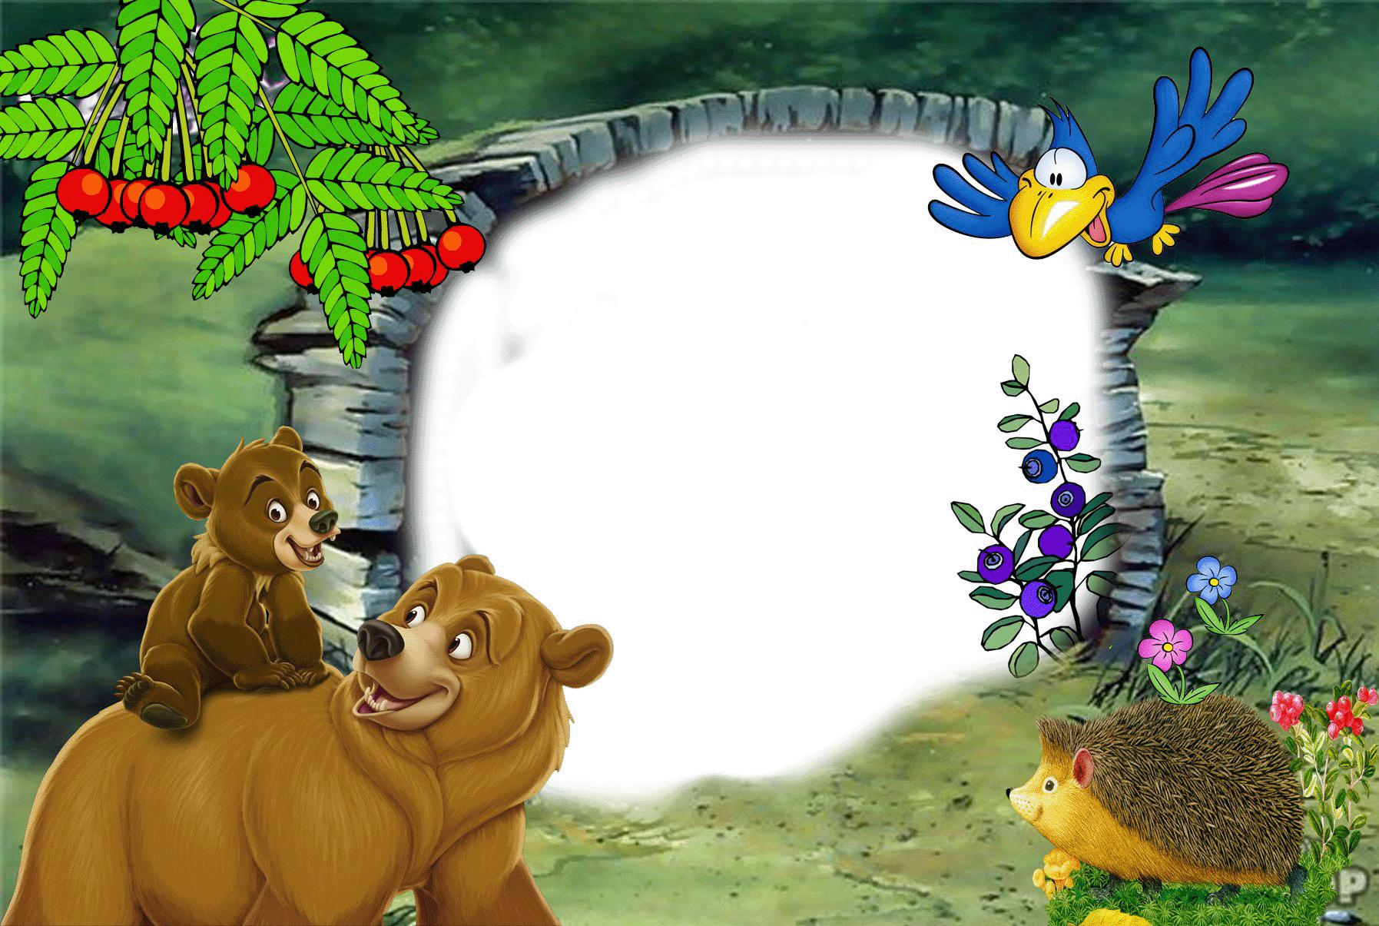
I wish you success!!!

Slide 5
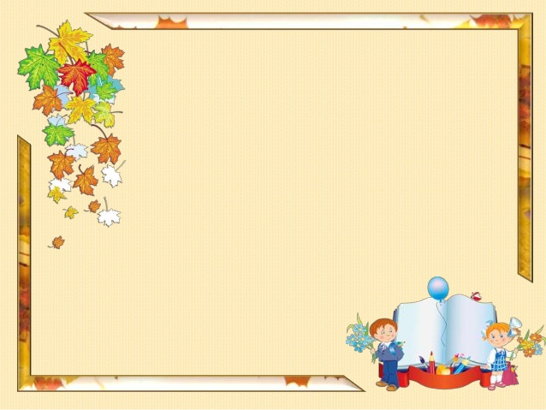
John ………. a student.
is
are
Am

Slide 6
Sarah …. A pupil
Am
are
is

Slide 7
I……10
Are
Is
Am

Slide 8
We ….from Kazakhstan.
Are
Is
Am

Slide 9
They …..doctors.
Is
Am
are

Slide 10
Open the brackets in Present Simple:

Slide 11
He (visit) his friends every day.
Visiting
Visit
Visits

Slide 12
I (go) to school at 8 o’clock.
Go
Goes
Going

Slide 13
They usually (take) a shower after exercises.
Take
Takes
Taking

Slide 14
Mary (help) her mother every day.
Help
Helps
Helping

Slide 15
Bob and Charlie (do) exercises.
Do
Does
Doing

Slide 16
Open the brackets in Present Continuous

Slide 17
I (watch) TV now.
Watch
Am watching
watching

Slide 18
He (clean) his teeth.
Cleaning
Clean
Is cleaning

Slide 19
They (wash) hands.
Wash
Are washing
Washing

Slide 20
We (play) football.
Are play
Are playing
play

Slide 21
It (rain) now.
Rains
Is raining
Raining

Slide 22
Translate:

Slide 23
Менің анамның есімі Сара.
My mother name is Sarah.
My mother’s name Sarah.
My mother’s name is Sarah.

Slide 24
Олар футболды жақсы ойнайды.
They are playing football.
They play football bad.
They play football well.

Slide 25
Менің хоббиім баскетбол ойнау.
My hobby is basketball.
My hobby play basketball.
My hobby is play basketball.

Slide 26
Сыныпта 15 үстел бар.
There are 15 table in the classroom.
There is 15 tables in the classroom.
There are 15 tables in the classroom.

Slide 27
Үстелдің үстінде ручка бар.
There are pen on the table.
There is pen on the table.
There is a pen on the table.

Slide 28
………five pens on the table.
There isn’t
There are
There is

Slide 29
…….a car in the garage.
There is
There are
There aren’t

Slide 30
……..some books on the table.
There is
There isn’t
There are

Slide 31
…….fifteen chairs in the classroom.
There is
There are
There isn’t

Slide 32
………..a cat under the armchair.
There are
There is
There are not

Slide 33
Mister Sybil ……two brothers.
Have got
Have
Has got

Slide 34
Bob and Sarah ……..a toy car.
Have
Has
Hasn’t

Slide 35
He………a headache.
Have
Haven’t
has

Slide 36
Jim …….a cat.
Has
Have
Haven’t

Slide 37
The sisters……….a brother.
Has
Have
Hasn’t

Slide 38
What do you see with?
Eyes
Ears
nose

Slide 39
What do you hear with?
Nose
Mouth
Ears

Slide 40
What do you write with?
Hand
Foot
mouth

Slide 41
What do you eat with?
Nose
Mouth
Ears

Slide 42
What do you walk with?
Hand
Feet
Shoulder

Slide 43
I get and then ………..
Come home
Do exercises
Go to school

Slide 44
I wash my hands and………..
Shoulder
Table
face

Slide 45
I play football and then I ………….
Take a shower
Eat coffee
Read the films

Slide 46
I wash my hands before………
Go
Eat
run

Slide 47
After school I…………
Go to school
Come home
Do exercises.

Slide 48
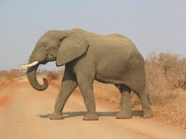
Big leg, little ears, short tail
Big leg, big body, short nose
Big ears, long nose, big legs

Slide 49
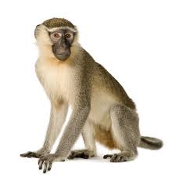
Long tail, little ears, short arms
Short tail, long arms, big ears
Long tail, long arms, little nose

Slide 50
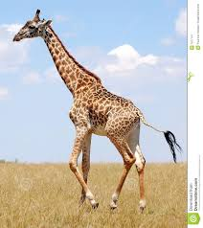
Long neck, short legs, short tail
Long neck, long legs, little ears
Short tail, long legs, big ears

Slide 51
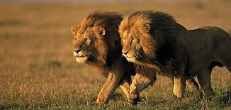
Big body, short hair, short tail
Long tail, little ears, long hair
Big body, short legs, long tail

Slide 52
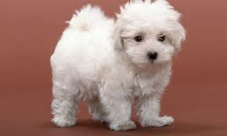
Little body, long legs, little eyes
Little ears, short tail, short ears
Long legs, short tail, little eyes

Slide 53
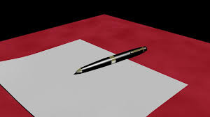
On the table
In the table
Under the paper

Slide 54
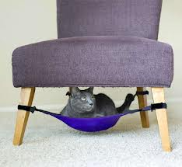
Under the book
In the box
Under the chair

Slide 55
On the box
Under the box
In the box

Slide 56
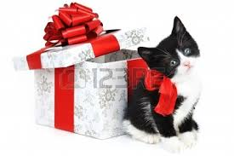
On the box
Near the box
In the box

Slide 57
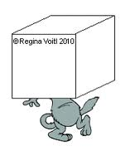
Under the box
In the box
Near the box

Slide 58
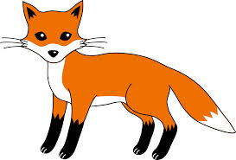
Red, white
Orange, black
Orange, black, white

Slide 59
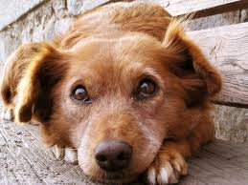
Black
Brown
Blue

Slide 60
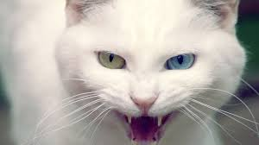
White
Whete
Pink

Slide 61
Black
Grei
Grey

Slide 62
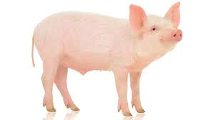
Red
Pink
Orange

Slide 63
Open the brackets in Past Simple:

Slide 64
I (go) to the cinema yesterday.
Goed
Went
go

Slide 65
Bob (watch) TV last night.
Watches
Watched
watchd

Slide 66
Sarah (see) her friend last week.
Sees
Sew
saw

Slide 67
I (read) this book last year.
Read
Readed
Raed

Slide 68
I (do) exercises.
Do
Does
Did

Slide 69
Antonym of the word old:
Older
New
Newer

Slide 70
Antonym of the word little:
Bigger
Long
Big

Slide 71
Antonym of the word short:
Big
Long
shorter

Slide 72
Antonym of the word cold:
Warm
Hot
Colder

Slide 73
Antonym of the word white:
Blake
Brown
Black

Slide 74
ODD ONE OUT

Slide 75
Cat, men, women
Cat
Men
women

Slide 76
Cows, frog, sheep
Cows
Frog
sheep

Slide 77
Cat, dog, fox
Cat
Dog
fox

Slide 78
Dogs, frog, man
a. Dogs
b. Frog
c. man

Slide 79
Beautiful, horse, rabbit
Beautiful
Horse
rabbit

Slide 80
Good work!!!

Slide 81
