Slide 2
“The ABC quiz”

Slide 3
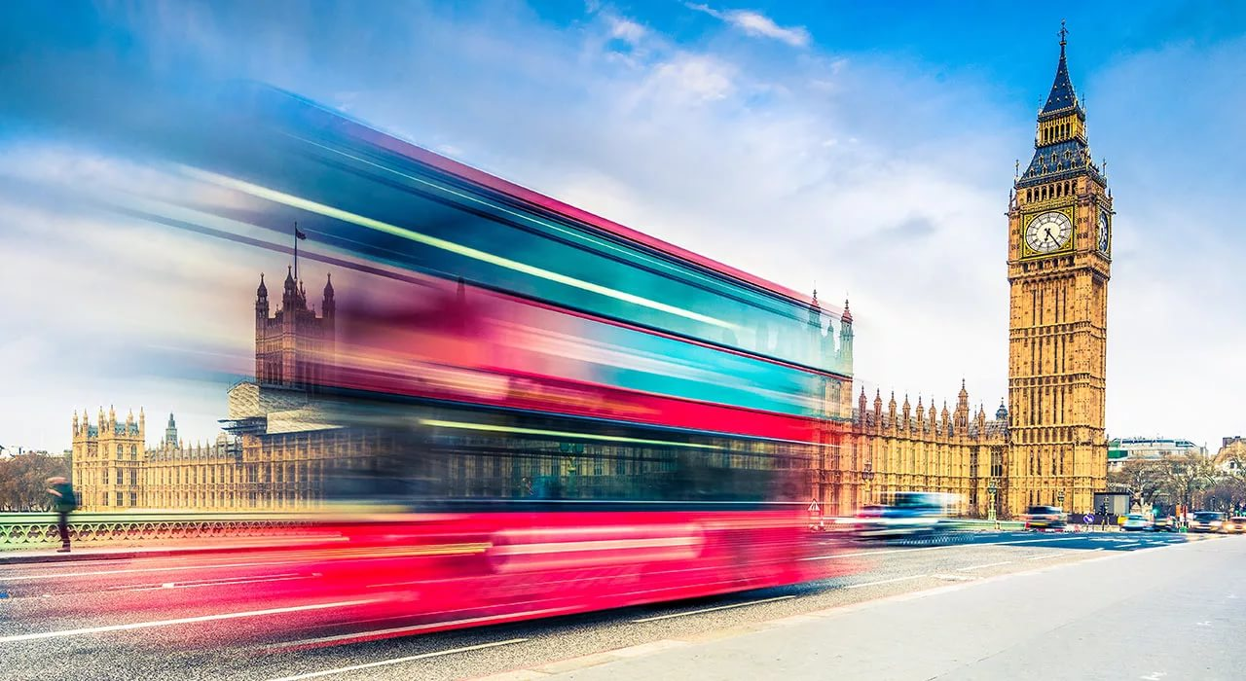
Speaking letters

Slide 4
“Taking steps”

Slide 5
“What colour is it?”

Slide 6
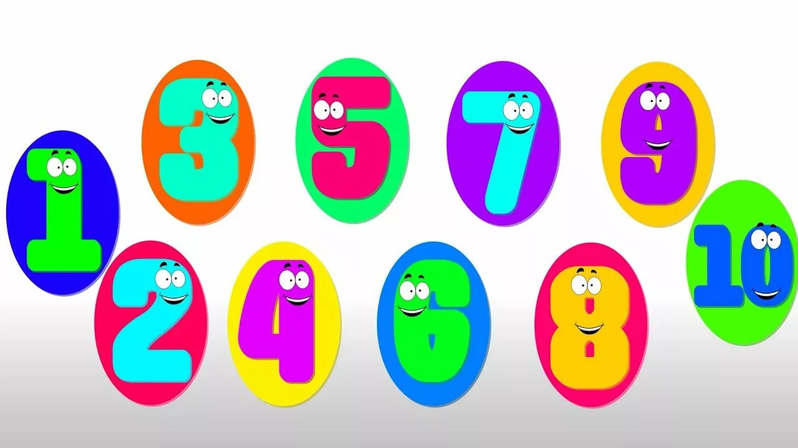
“Find the number”

